Slide 1
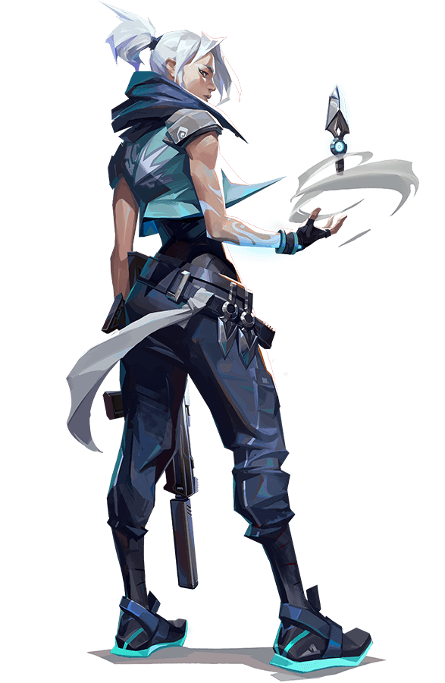

VALORANT
By: Oliver Einarsson, Gina Fender, Acarie Jenkins, Naomi Martin,
& John Xuereb
9-5-2023

Slide 2
INTRODUCTION
What is Valorant?

Slide 3
Valorant: At a Glance
5v5
22
17
13
Players
Agents
Weapons
Maps
03

Slide 4
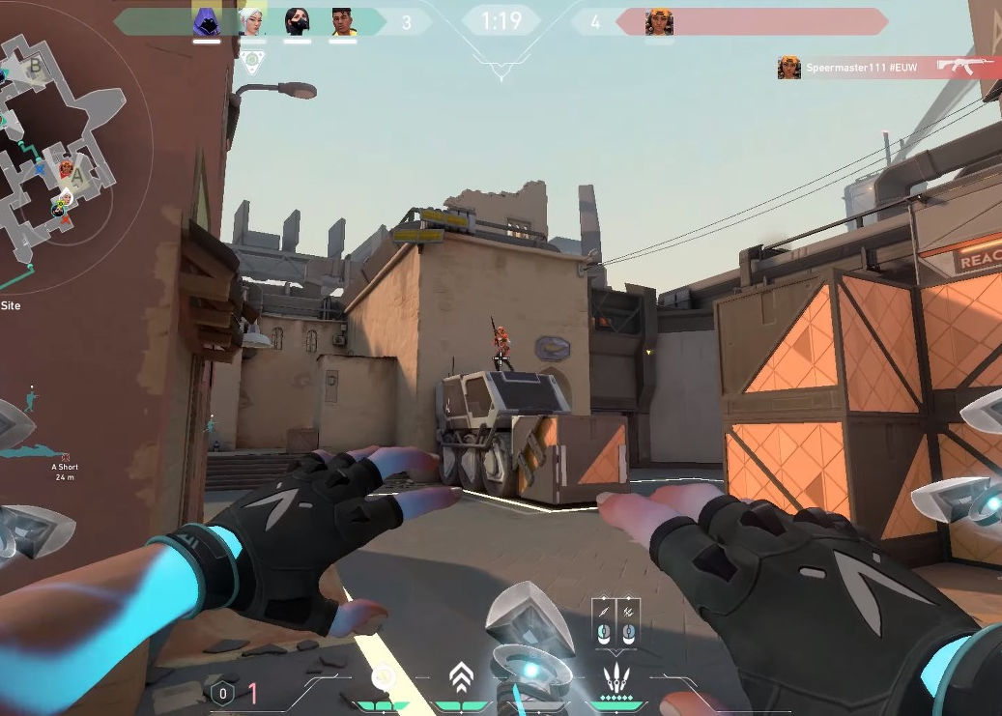
Our Focus
Users Will Be Able To:
Access statistical data
Determine the best areas for gameplay and predict the outcome of a game based on scores
04

Slide 5




HOW IT WORKS?
Python
Jupyter Notebooks
HTML
SQLite
05

Slide 6
HOW IT WORKS?
Machine Learning
Model
API
JavaScript
Flask
06

Slide 7
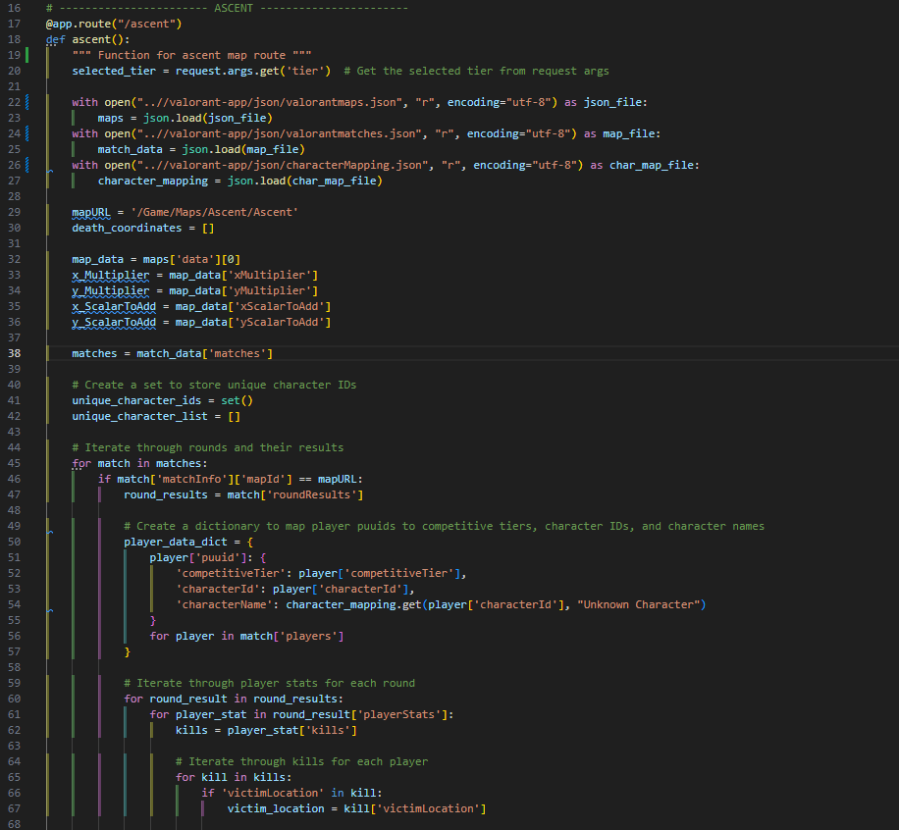

Flask Code
07

Slide 8
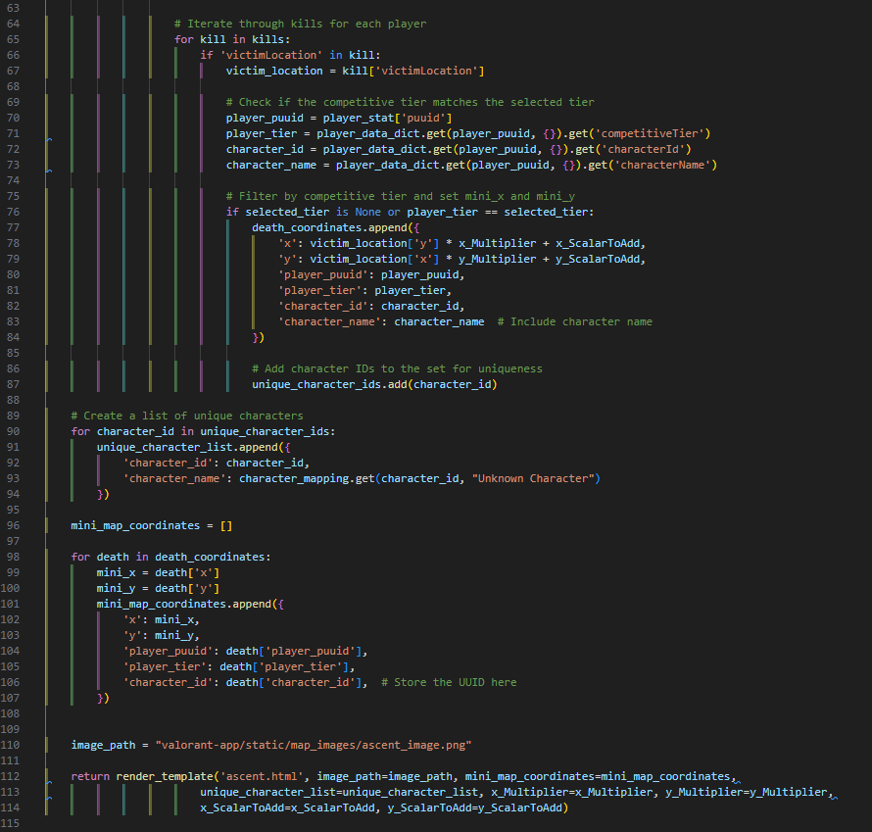
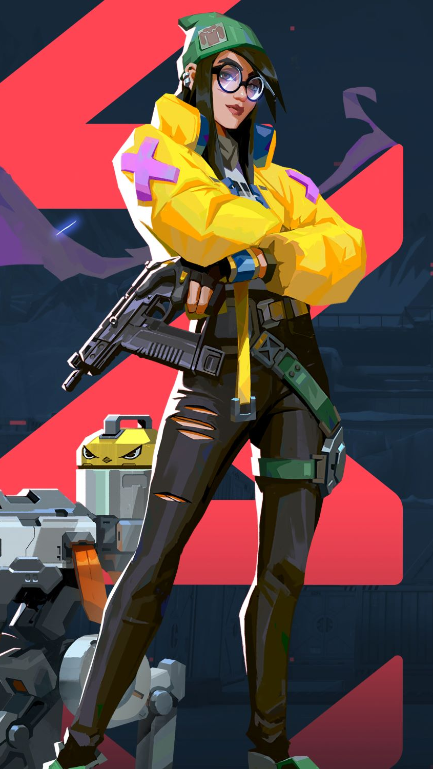
Flask Code Ctd.
08

Slide 9
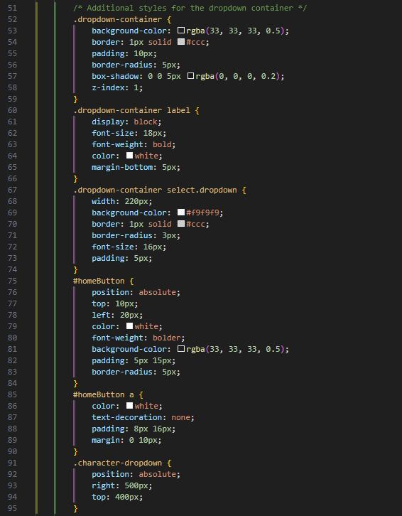
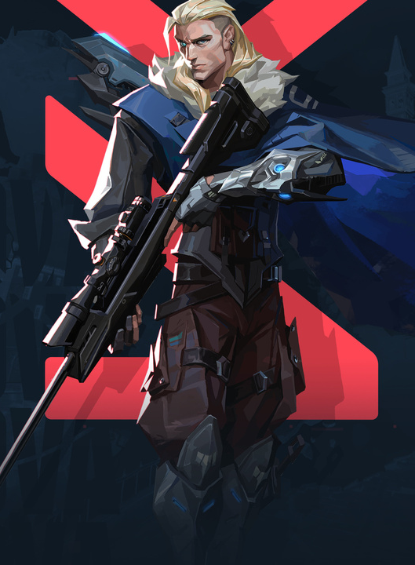
CSS/HTML: Ascent Map
09

Slide 10
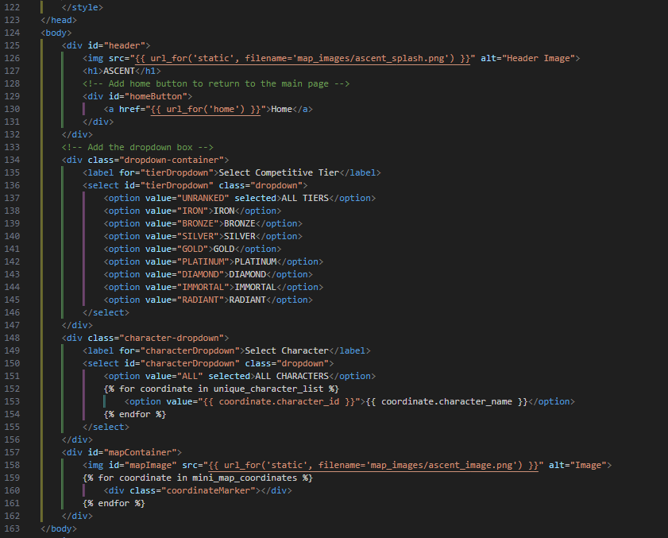
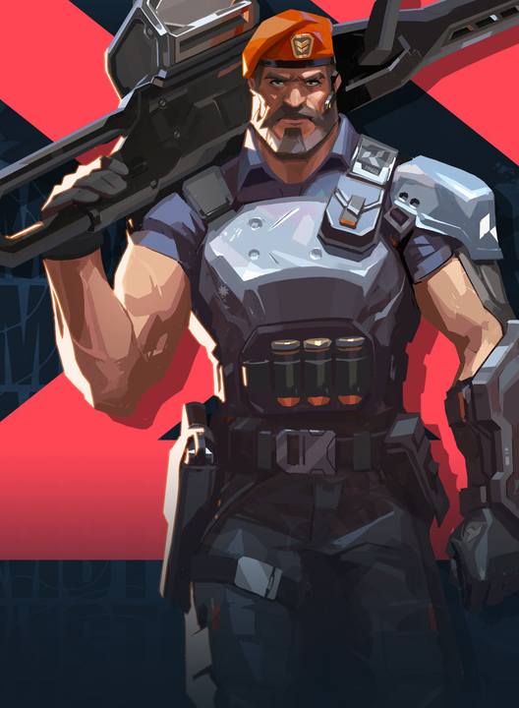
CSS/HTML: Ascent Map ctd.
10

Slide 11
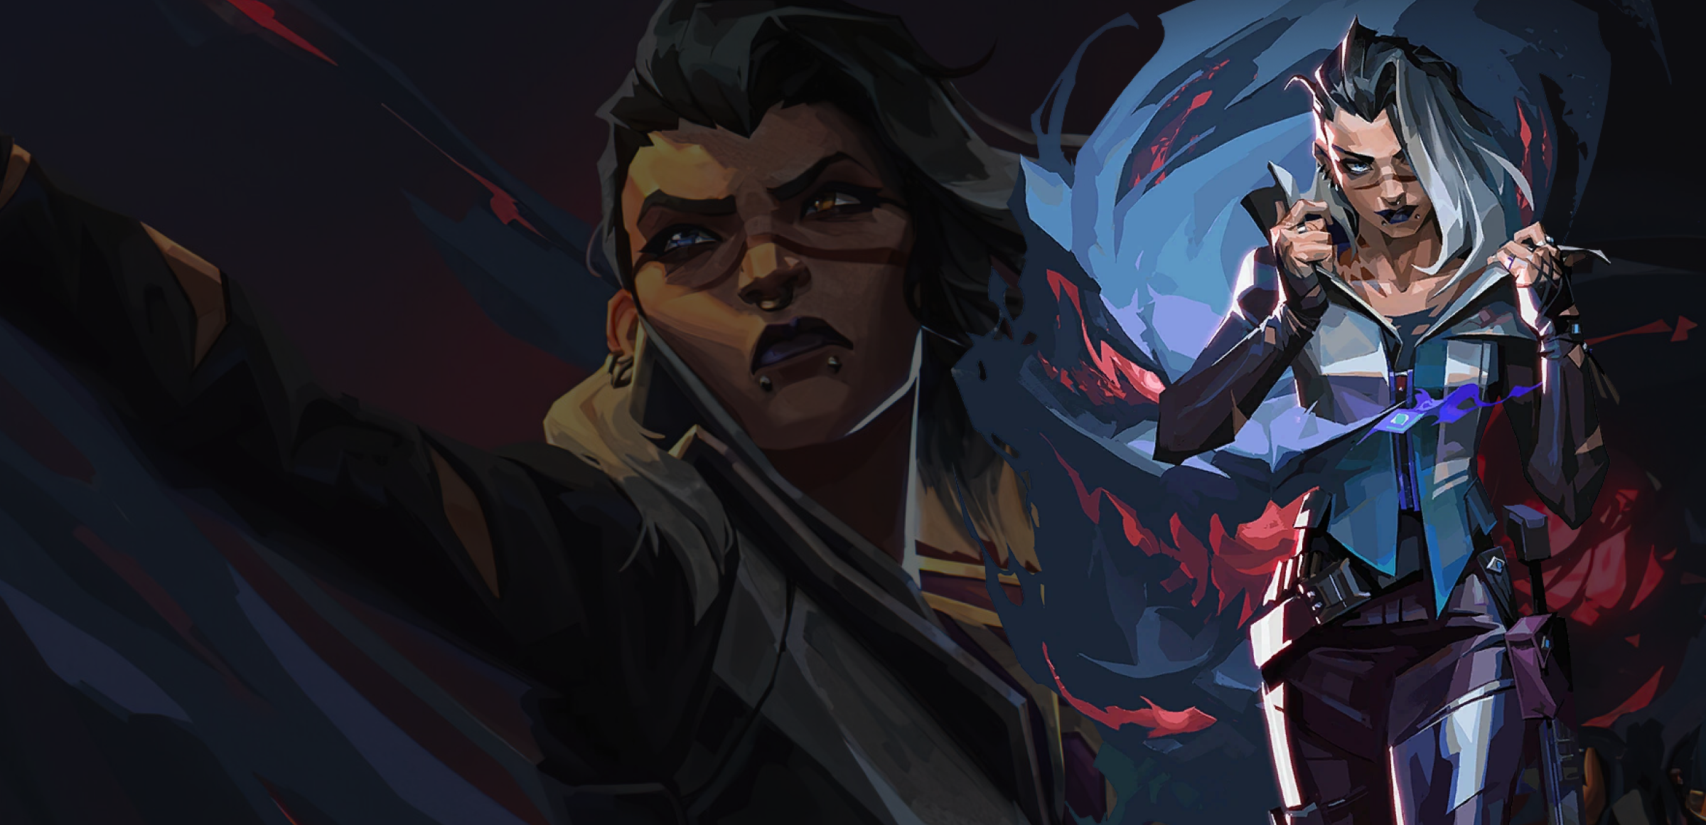
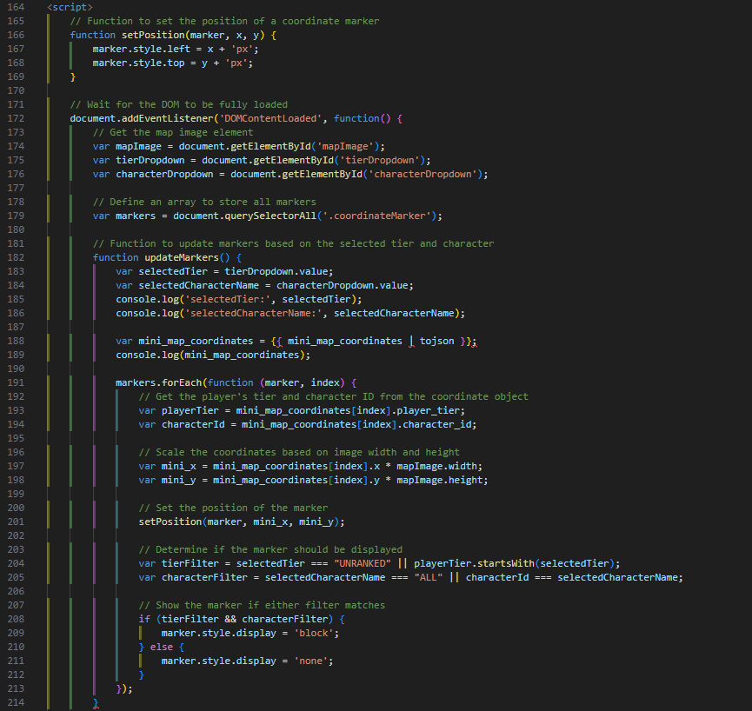
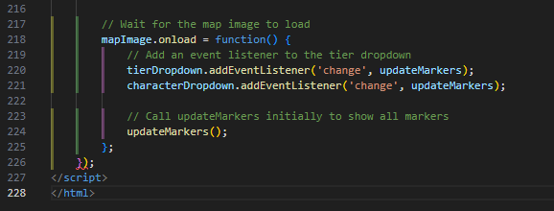
20
FADE
Javascript
11

Slide 12
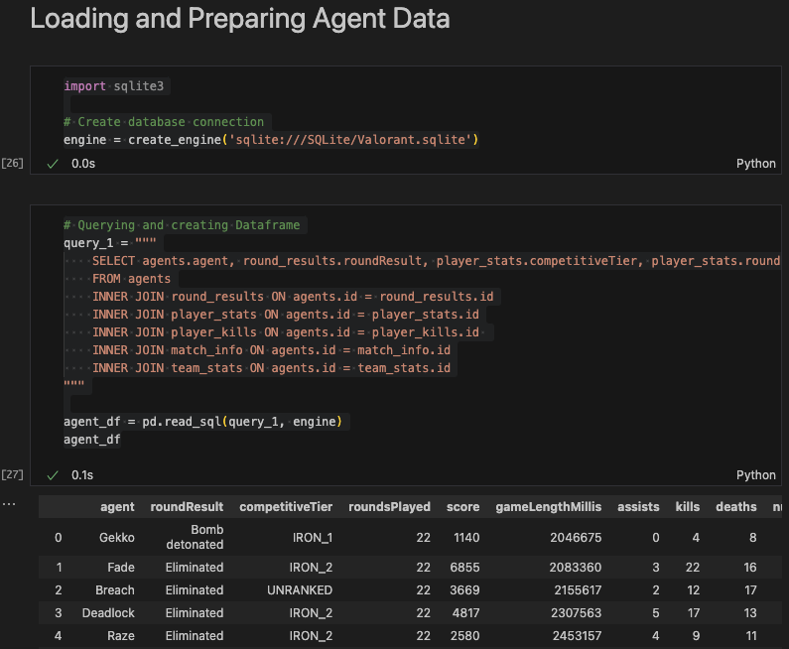
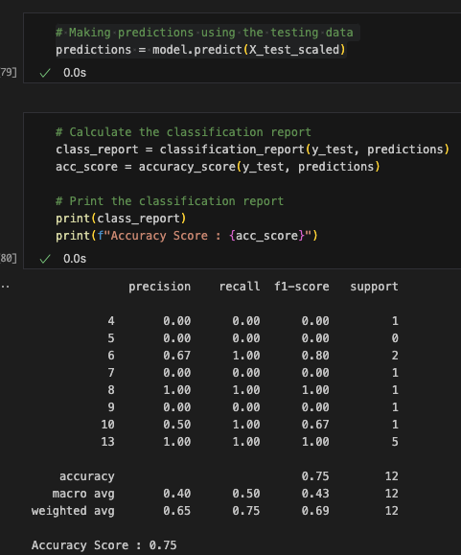
MACHINE LEARNING MODEL
DECISION TREE MODEL
12

Slide 13
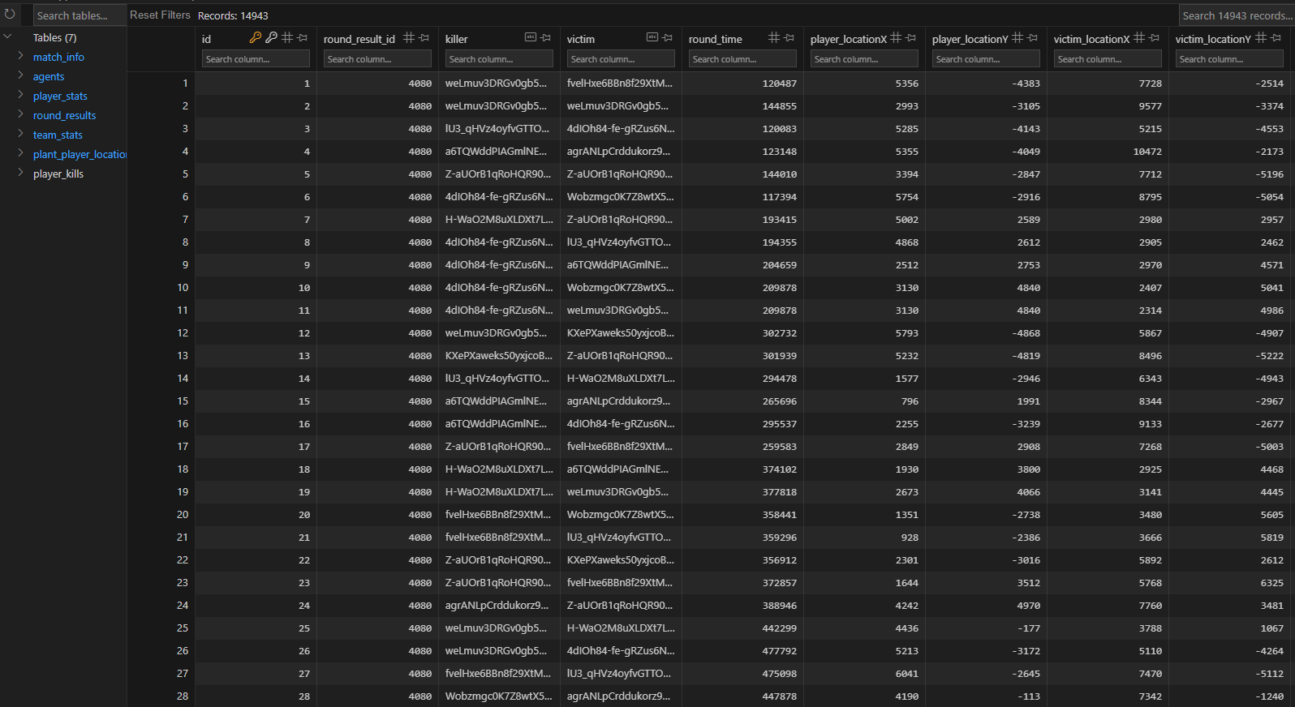
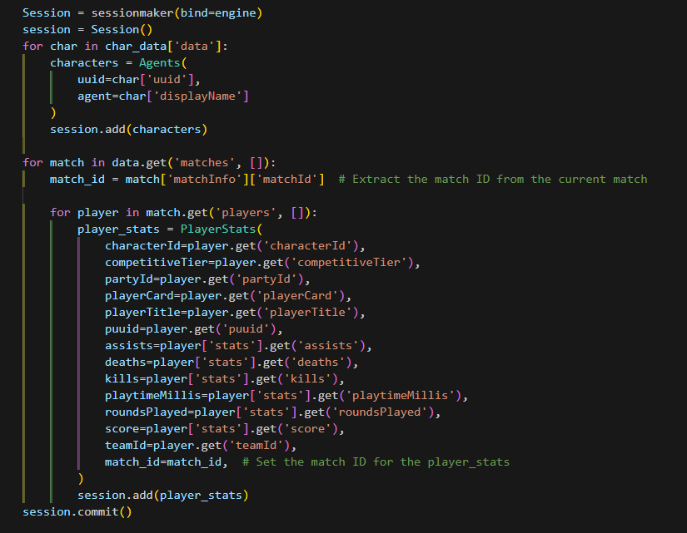
SQLITE DATABASE
13

Slide 14
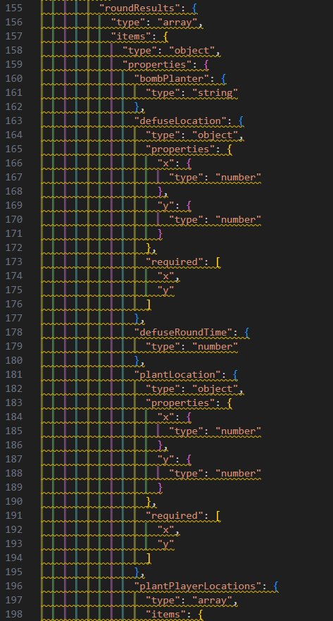
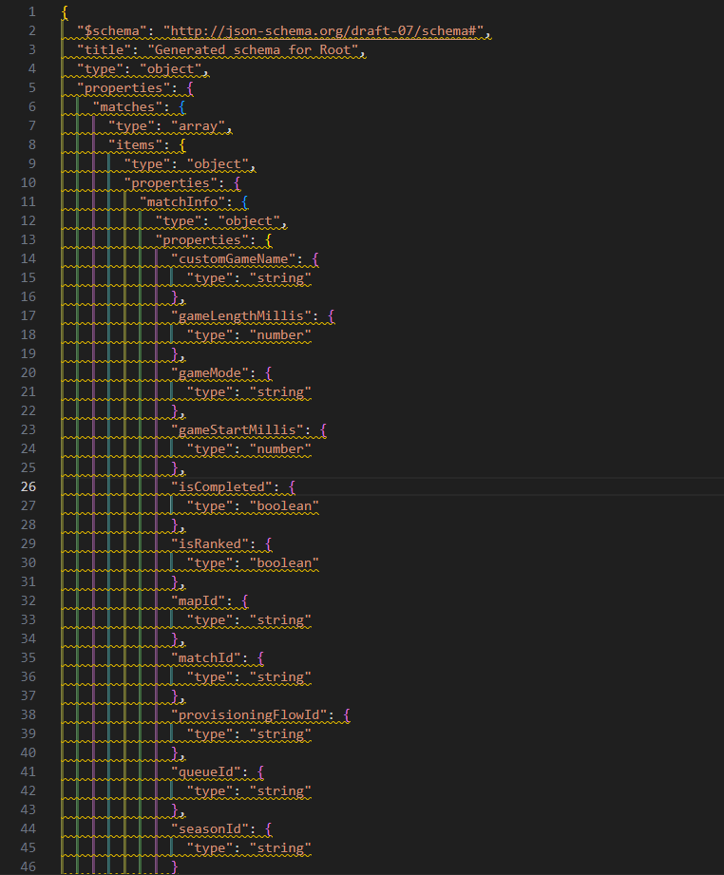
JSON SCHEMAS
14

Slide 15
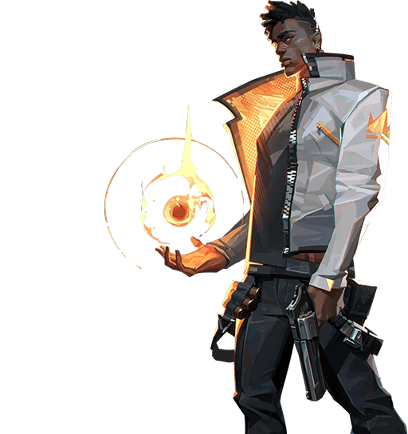
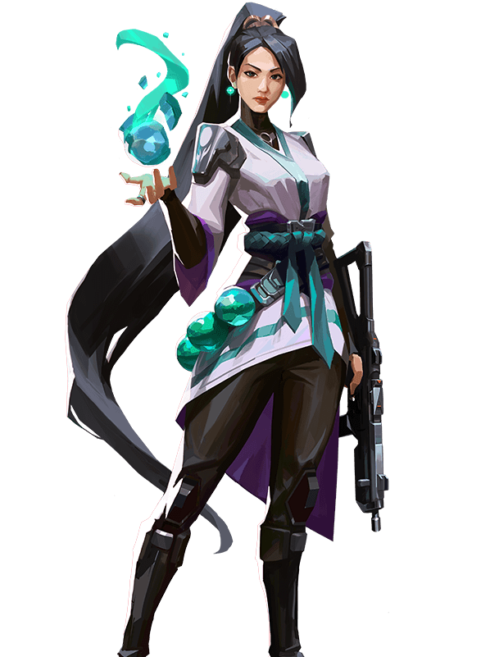
CONCLUSION
Gina Fender
John Xuereb
Acarie Jenkins
Oliver Einarsson
Naomi Martin

